Slide 1
PREDICTION OF DOWNHOLE PRESSURE USING MACHINE LEARNING MODELS
SUPARNA BHATTACHARJEE, SRUTHI KARICHERI, JENNIE RAN
FINAL PROJECT, Data Analytics Boot Camp RICE University

Slide 2

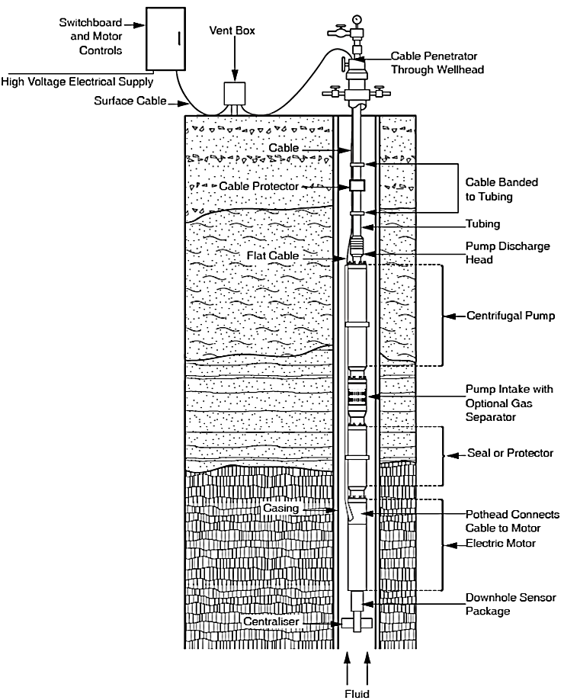
OBJECTIVE
Well Head Measurements
(Input Variables)
Predict downhole pressure from wellhead data for the feasibilities of :
Well completion without downhole gauges.
Reduction of the completion cost.
Avoiding shutdown time for gauge/sensor maintenance.
Average Downhole
Pressure
(Target Variable)

Slide 3
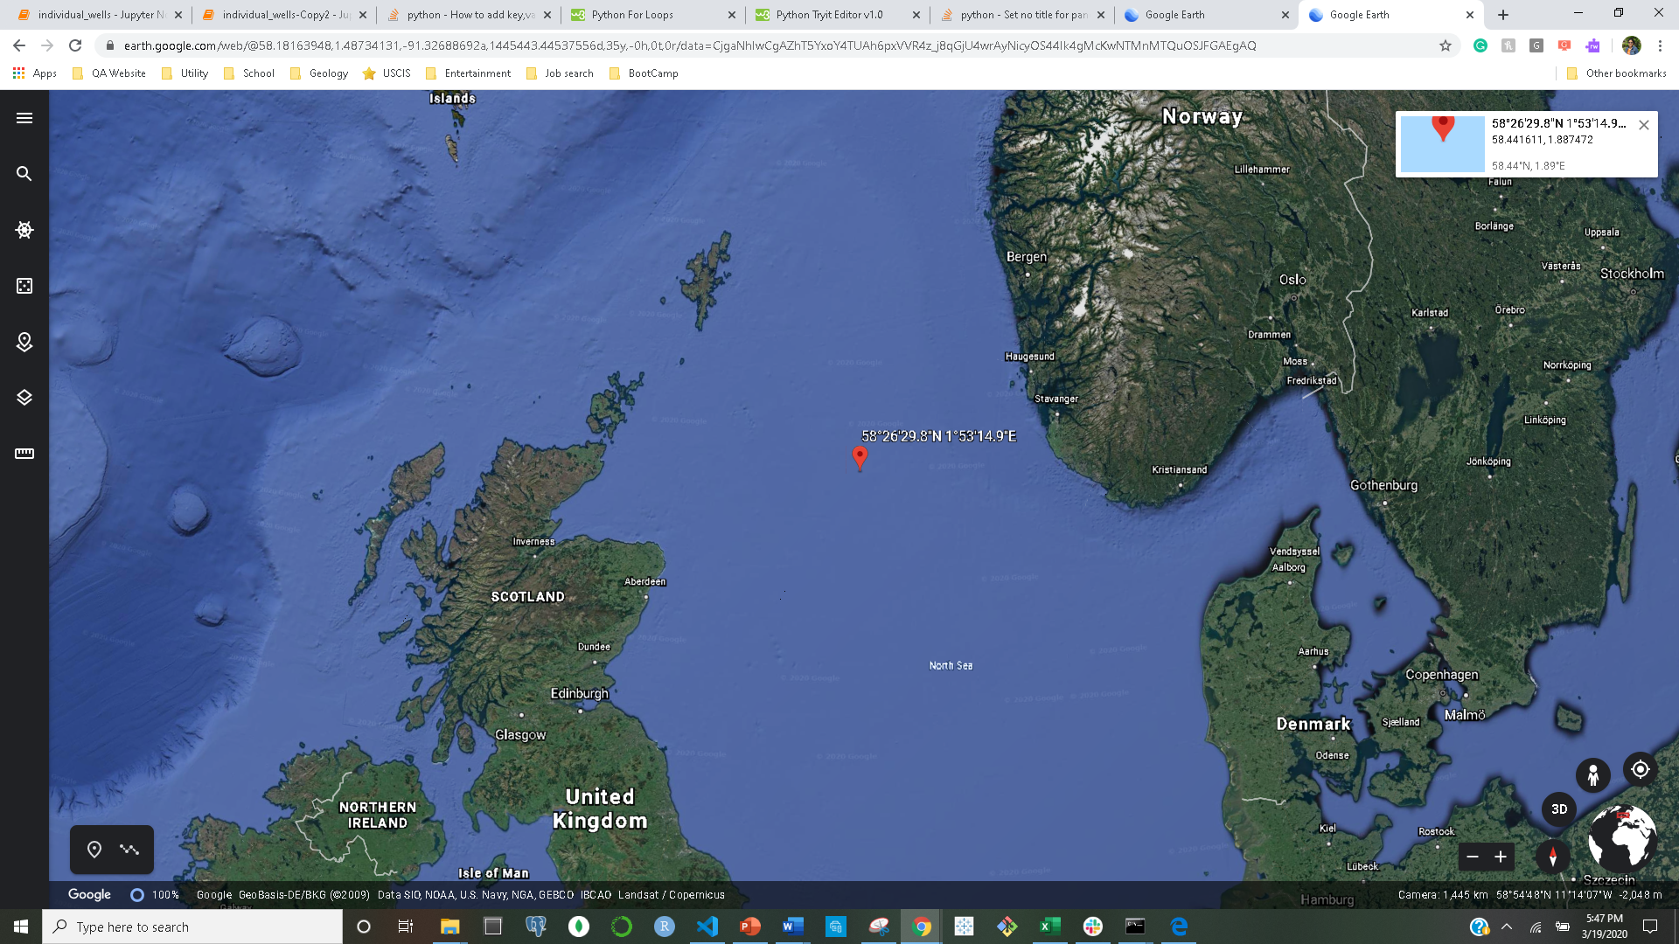
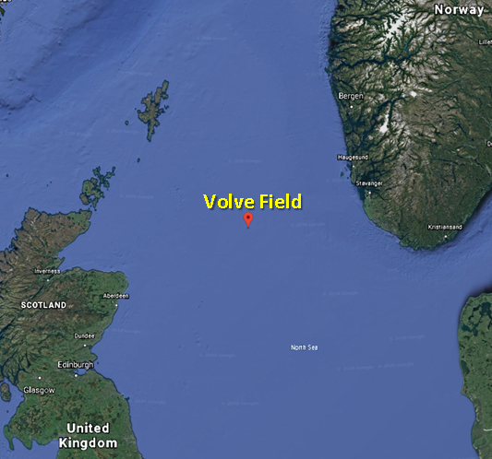
DATA SOURCE
Production data from the Volve Field, North Sea.
Released by Equinor in 2018.
Structured data from five production wells.
Duration 2008 to 2016.
Set of 24 categorical and numerical data from both wellhead and downhole measurements.
Volve Field

Slide 4
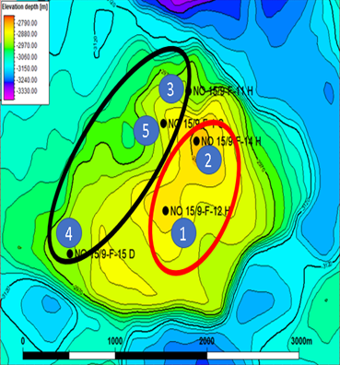
DATA INTRODUCTION
Two discovery wells are on the crest of the structure.
Production since 2008
Highly deviated to horizontal wells
Three appraisal wells are on the flank.
Production since 2013-14
Highly deviated to horizontal wells

Slide 5
SCOPE OF THE PROJECT
Analysis: Understanding the relationships of different variables
Goal: Prediction of Average Downhole Pressure
Input p
Input p
Input Parameters
Machine Learning Model
Target
Variable
1.Average Choke Size
2. Average Wellhead Pressure
3. Average Wellhead Temperature
4. Bore Oil Volume
5. Bore Gas Volume
6. Bore Water Volume
1.Average Downhole Pressure
BENEFITS:
Help forecasting the well potential during the life cycle of the well.
Provide information on pore pressure
Notes:
Knowing the bottom-hole pressure of an oil well can help forecasting the well potential during the life cycle of the well. In other words, well production monitoring and artificial lifting optimization can be performed, which is a key objective for oil production maximization and operational cost reduction [12]. Bottom-hole pressure data also can be used to provide information on pore pressure that can be calculated for safety while drilling development wells in the area. It is critical for drilling operations especially underbalanced drilling. This also provides valuable data to select accurate kill fluid weight. The data also can be used to improve accurate under- or over-balance before perforation.

Slide 6
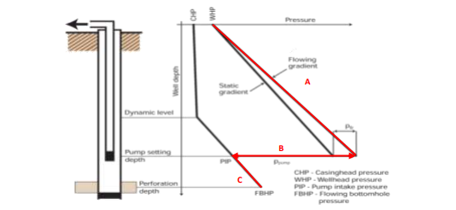
Parameters
Choke Size
Wellhead Pressure and Temperature
Downhole Pressure and Temperature
Production Output – Bore Volume of Oil, Gas and Water
Fig; Typical Drop Pressure Profile
Notes:
CHOKE SIZE : this is a layman's definition but Choke refers to a mechanical device placed in the flow line to restrict and control the flow of gas. It is usually expressed in 64ths of an inch on fixed chokes or it can be a decimal value on adjustable chokes. A 64/64 choke would be full open flow. As to the effects on production rates... basically, the smaller the choke... the less gas produced but it will flow at higher pressure. Opening the choke reduces the flowing pressure. There are as many schools of thought as to the best way to flow a shale well as there are operators, I imagine, but generally they are mostly using a "smallish" choke (less than 20/64), initially, where in the beginning of the play it was fairly common to see shale wells with 24/64 or larger choke. Some of these wells are so over-pressured that they have to be flowed on a bigger choke until the pressures come down a little and then they are choked down some more. Standard approach for the Haynesville Shale are choke sizes of 20/64" to 26/64" while the "restricted" choke size is generally in the 14/64" to 16/64" range. Normally choke sizes are increased (opened) over time until flowing pressure reaches line pressure (~ 1000 psi). I assume the operator would decrease the choke size initially when a well is dropped into a lower pressure gathering system (~ 300 to 500 psi).Most natural gas wells are produced initially on choke to avoid damaging the formation and/or downhole and surface equipment. Chokes can be located on the wellhead or in the flow line upstream of the production separator.
WELLHEAD PRESSURE: Wellhead pressure – pressure at the top of the well, i.e., at its wellhead. It is measured by pressure gauges of the wellhead fittings. There are static and dynamic wellhead pressures.
Static wellhead pressure is gauged in the abandoned well and depends on reservoir pressure, well depth and density of the filling medium. Numerically it equals the difference between reservoir pressure and hydrostatic pressure of the liquid column from wellhead to reservoir.
Dynamic wellhead pressure is measured in the operating well and depends on the same parameters as the static pressure + on the well rate or on injection agent flow rate, as well as on the pressure in the pipeline near the well and on the pressure differential in shut-off elements of the wellhead fittings. Excess wellhead pressure (versus atmospheric pressure) may reach 100 MPa and more (in gas wells, at hydraulic fracture).
BP and the Coast Guard are watching the pressure at the wellhead very, very closely because of what it will mean for the future prospects of this well. Pressure readings under a critical threshold usually mean that there may be leaking elsewhere in the system. If there is a single leak, it will be more easily diagnosed and remedied depending on where it is. If there is more than one leak present, a whole set of different challenges emerges. Most importantly, keeping the system under pressure, when leaks exist anywhere, will inevitably increase the potential for those leaks to worsen.
DOWNHOLE PRESSURE - A permanent downhole gauge (PDG) is a pressure and/or temperature gauge permanently installed in an oil or gas well. Typically they are installed in tubing in the well and can measure the tubing pressure or annulus pressure or both. Systems installed in well casing to read formation pressure directly, suspended systems, and systems built in coil (continuous) tubing are also available. The data that PDGs provide are useful to Reservoir Engineers in determining the quantities of oil or gas contained below the Earth's surface in an oil or gas reservoir and also which method of production is best.
Permanent downhole gauges – are installed in oil and gas wells for the purposes of observation and optimization. The most prolific function of a downhole gauge is to monitor pressure at a single point or multiple points in a well. Temperature is the second most monitored factor. Permanent downhole gauges continue to evolve into many different types of sensors.
pressure
temperature
distributive temperature
noise
strain
flow
The information provided by a permanently mounted sensor enables smart well technology. A "smart well" is a well that can monitor information and make adjustments automatically. The adjustments will optimize production or protect the well. The vast majority of producing oil and gas wells in the world have no such instrumentation or capabilities. PDG's are important tools for optimal production and protection of our most important non-renewable resources.

Slide 7
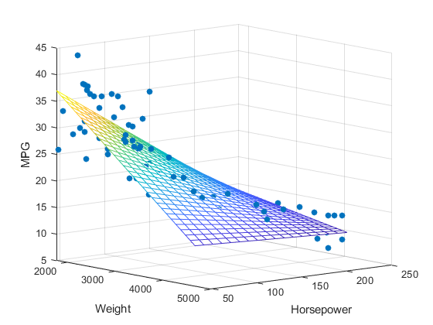
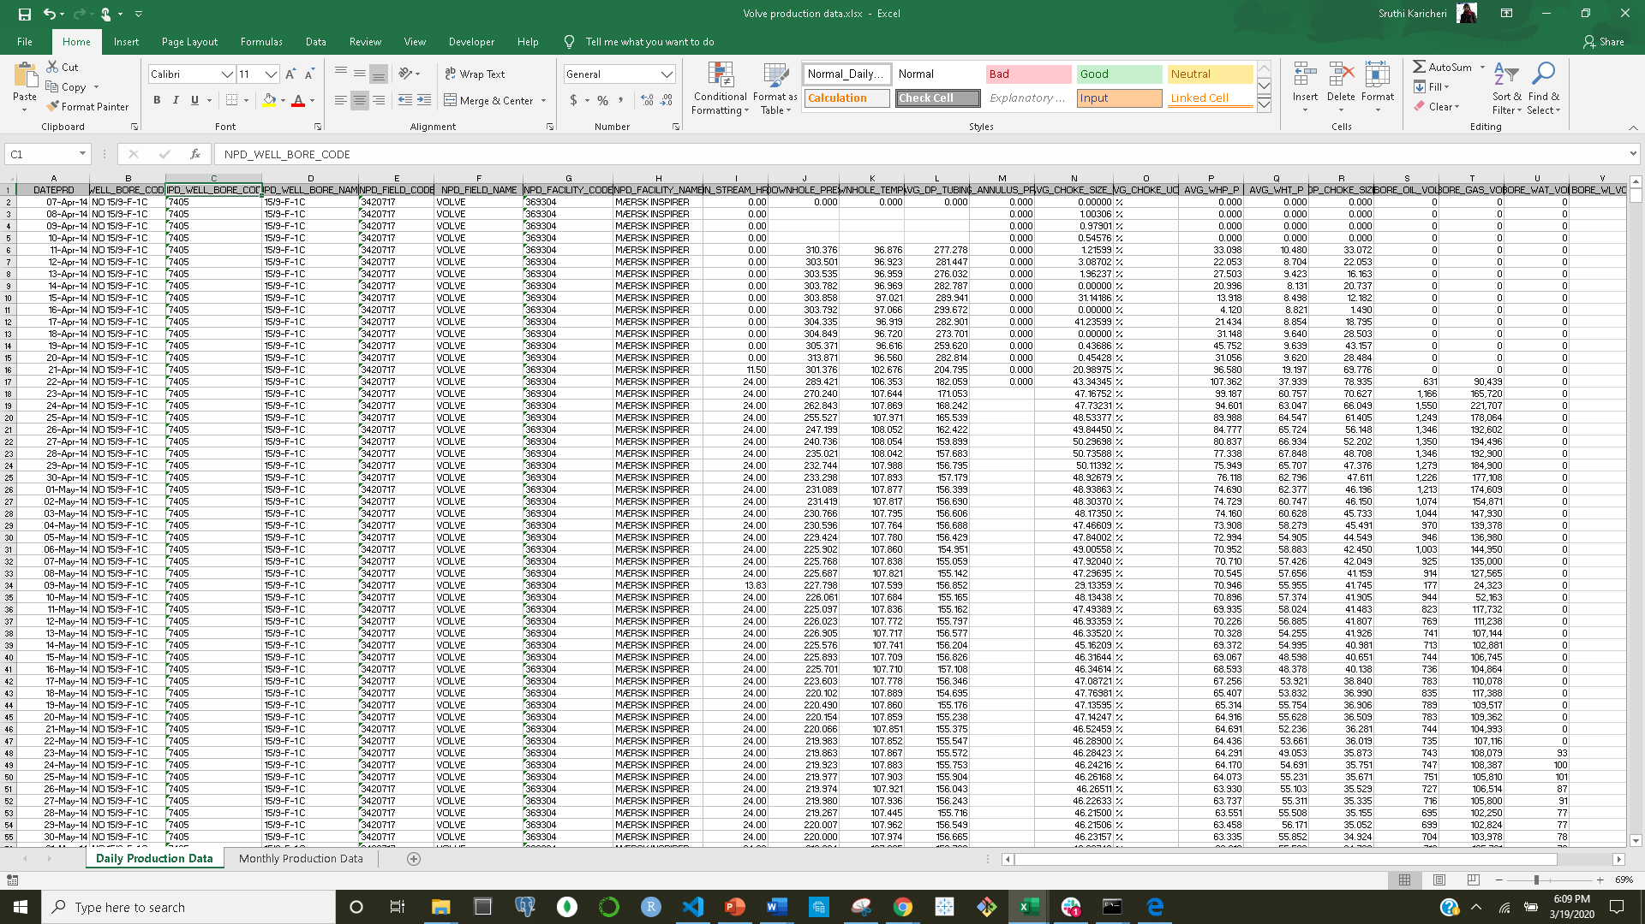
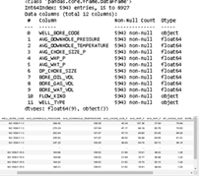
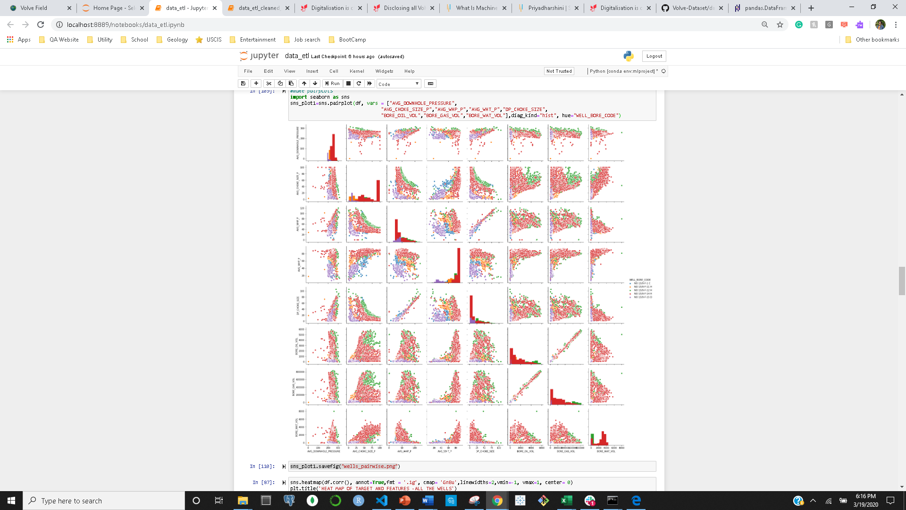


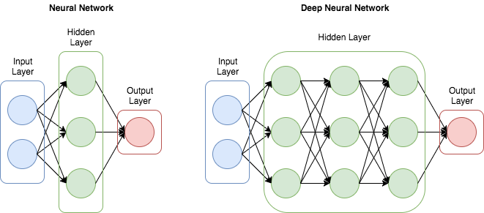
PROJECT WORKFLOW
Multi-Linear
model
Random Forrest
model
Raw Data File
Data Cleaning and Wrangling
EDA
Neural Network
model
ML

Slide 8
FEATURE AND TARGET VARIABLES
Surface Measurements
(Input Variable)
Derived and unrelated numerical variables avoided.
DP Tubing
DP Choke Size
Annulus Pressure
All categorical variables were also avoided.
Well Name
Well Type
Facility Code
Choke Size
Wellhead Pressure
Wellhead Temperature
Oil Volume
Gas Volume
Water Volume
Average Downhole
Pressure
(Target Variable)

Slide 9
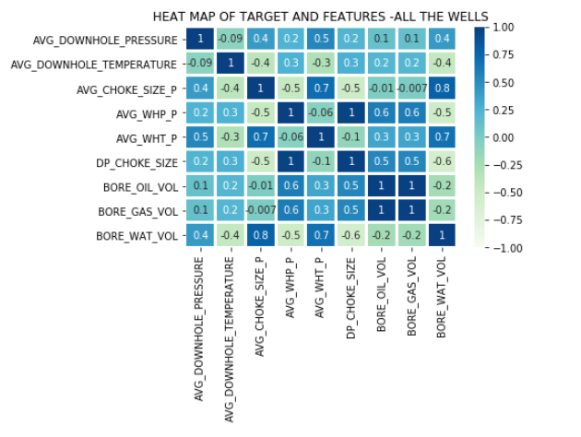
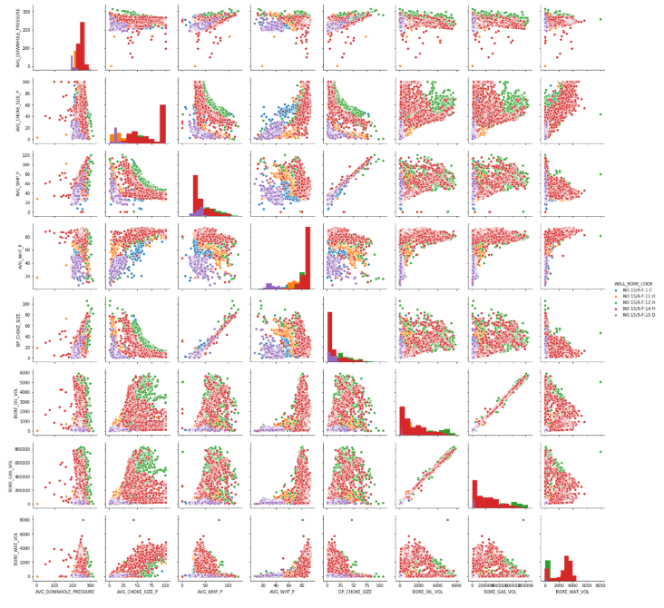
EXPLORATORY DATA ANALYSIS
Relationship between the features and target variable.
Scatter plots
Little or no Multicollinearity between the features.
Heat Map
Pairwise plotting

Slide 10
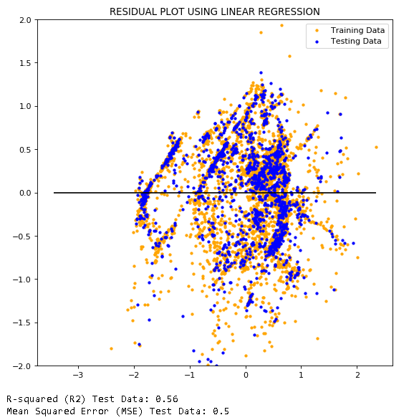
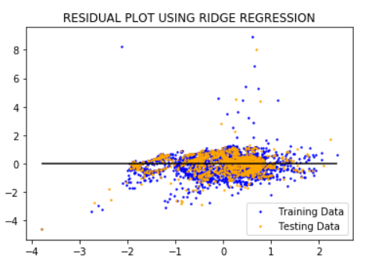
LINEAR AND RIDGE REGRESSION

Slide 11
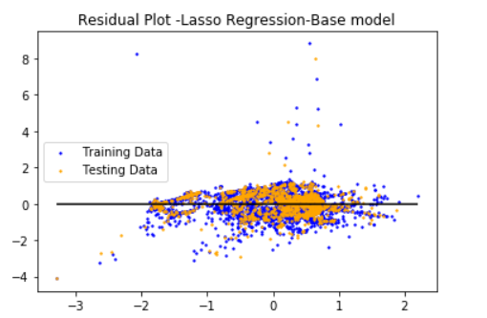
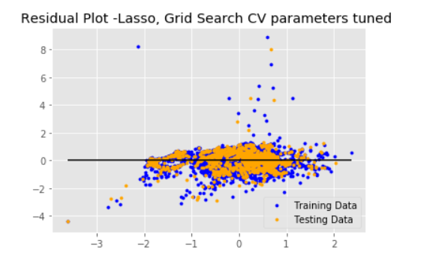
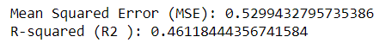
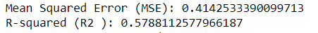
LASSO REGRESSION

Slide 12
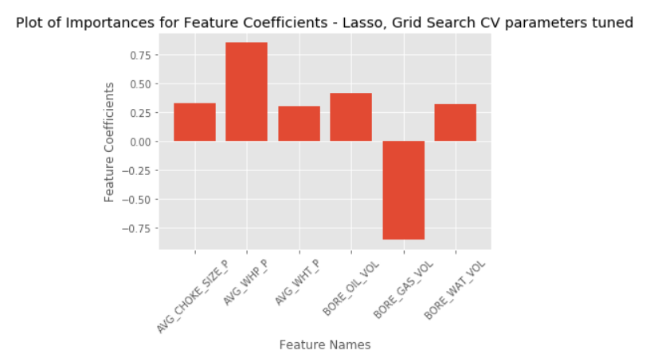
LASSO REGRESSION – GRID SEARCH CV

Slide 13
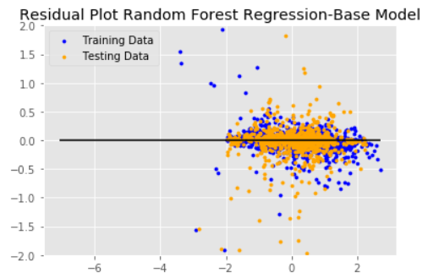
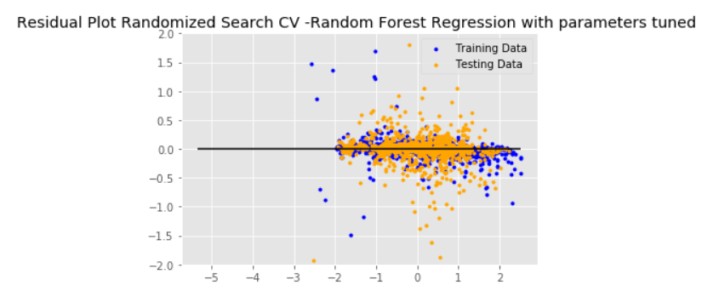
{
RANDOM FOREST REGRESSION
Notes:
Parameters tuned:
{'n_estimators': 522, 'min_samples_split': 2, 'min_samples_leaf': 2, 'max_features': 'sqrt', 'max_depth': 110, 'bootstrap': False}
N-estimators : The number of trees in the forest.
max_depthinteger or None, optional (default=None)The maximum depth of the tree. If None, then nodes are expanded until all leaves are pure or until all leaves contain less than min_samples_split samples.
min_samples_splitint, float, optional (default=2)The minimum number of samples required to split an internal node:
If int, then consider min_samples_split as the minimum number.
If float, then min_samples_split is a fraction and ceil(min_samples_split * n_samples) are the minimum number of samples for each split.
Changed in version 0.18: Added float values for fractions.
min_samples_leafint, float, optional (default=1)The minimum number of samples required to be at a leaf node. A split point at any depth will only be considered if it leaves at least min_samples_leaf training samples in each of the left and right branches. This may have the effect of smoothing the model, especially in regression.
max_featuresint, float, string or None, optional (default=”auto”)The number of features to consider when looking for the best split:
If int, then consider max_features features at each split.
If float, then max_features is a fraction and int(max_features * n_features) features are considered at each split.
If “auto”, then max_features=n_features.
If “sqrt”, then max_features=sqrt(n_features).
If “log2”, then max_features=log2(n_features).
If None, then max_features=n_features.
bootstrapboolean, optional (default=True)Whether bootstrap samples are used when building trees. If False, the whole datset is used to build each tree.

Slide 14
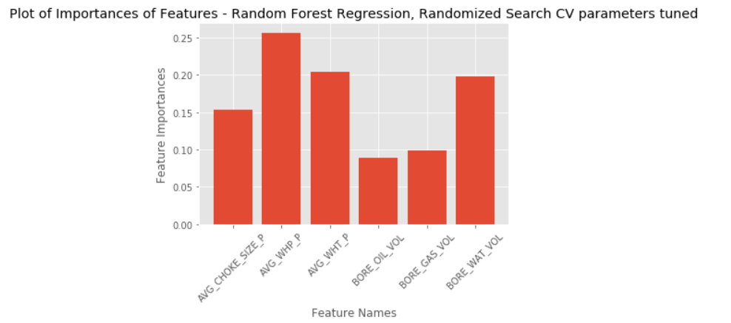
RANDOM FOREST REGRESSION – RANDOMIZED SEARCH CV

Slide 15
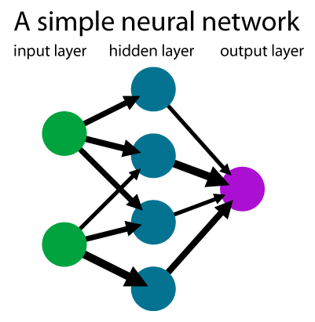
Neural Network
Keras Sequential Model
Basic model -> Overfitting
Tuning with Hyperas
Best model with hyper parameter optimization

Slide 16
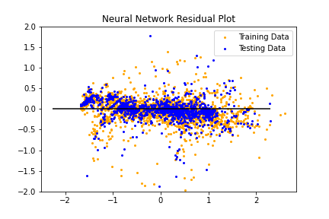
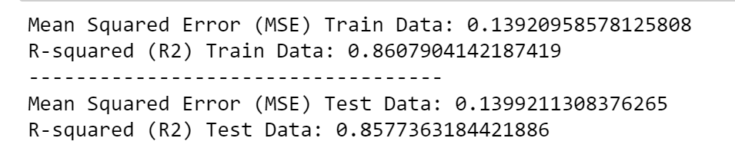
NEURAL NETWORK

Slide 17
ML RESULT SUMMARY
Model Scores
Model | MSE | R Squared
Multi-linear Regression Lasso shrinkage Lasso shrinkage (tuned) | 0.50 0.52 0.41 | 0.56 0.46 0.58
Random Forest Random Forest (tuned) | 0.17 0.12 | 0.82 0.87
Neural Network | 0.17 | 0.886

Slide 18
CONCLUSION
Complex relationship between the input variables and the target variable.
Well Head Pressure is the most important feature contributing to the prediction of the Downhole Pressure.
Future Scope of Study

